Slide 1
Student Affairs Key Performance
Data Science Capstone - Revision
Dan Reilly
May 6, 2018

Slide 2
Disruption
Division does not currently have well defined understanding of which of their key performance measures contribute to student success.

Slide 3
Key performance Measures
Sense of Belonging
Level of University Engagement
Thoughts of Leaving School
Resiliency
Satisfaction

Slide 4
Proposed Outcomes
Academic Success
Retention
Graduation

Slide 5
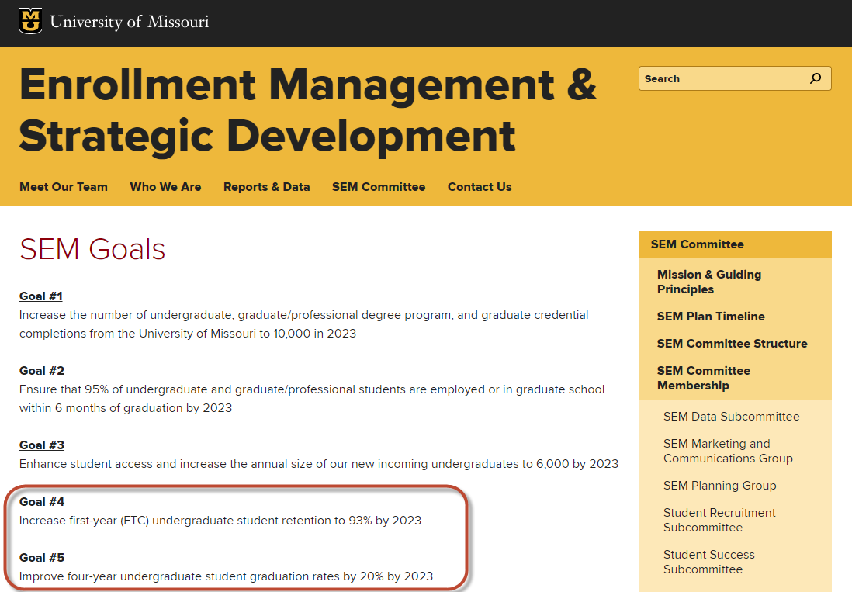

Slide 6
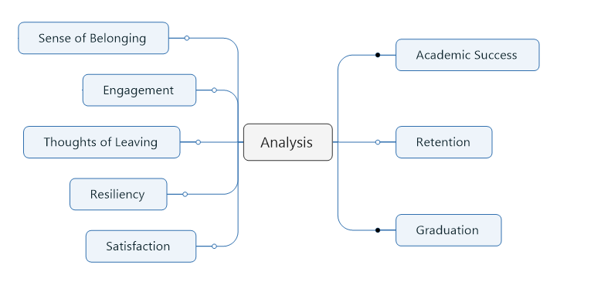

Slide 7
Data Sources
Student Experience Survey (CampusLabs – SPSS)
Student Information System (SQL & Tableau)
Retention Table
Census Data
OrgSync – Campus Involvement (API to Excel)
MU Connect – Predictive Analytic Module (API to CSV)

Slide 8
2017 Student Life Survey
Implemented Spring of 2017 – related to Outcomes measure in Spring 2018
1,247 Responses from 7,000 randomly sampled students
5,000 Undergraduates (N = 877)
2,000 Graduates (N = 370)
18% Overall Response Rate
17.5% Undergraduate
18.5% Graduate
Notes:
Note – confidential study

Slide 9
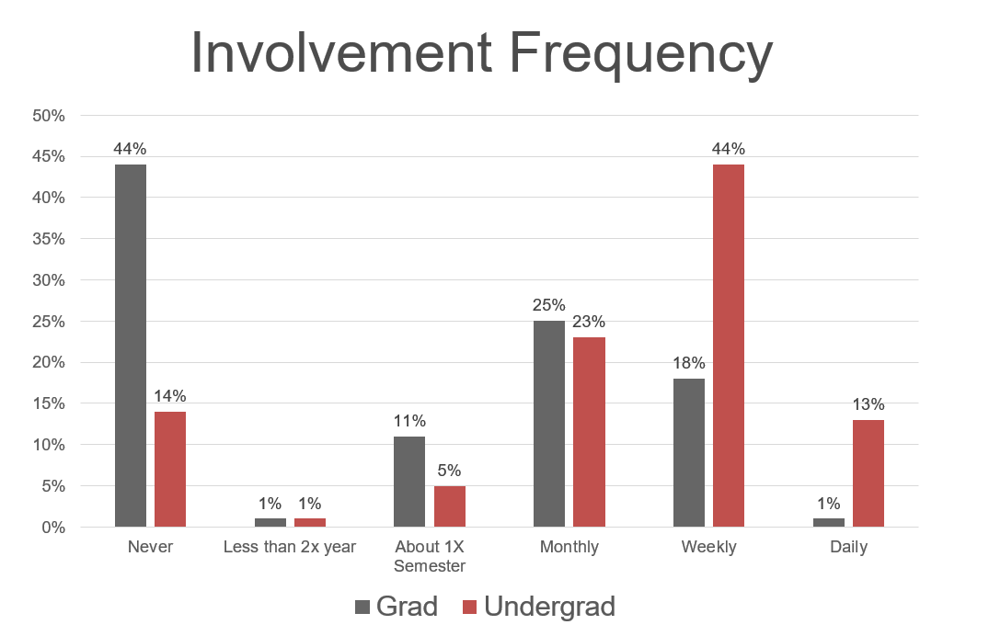
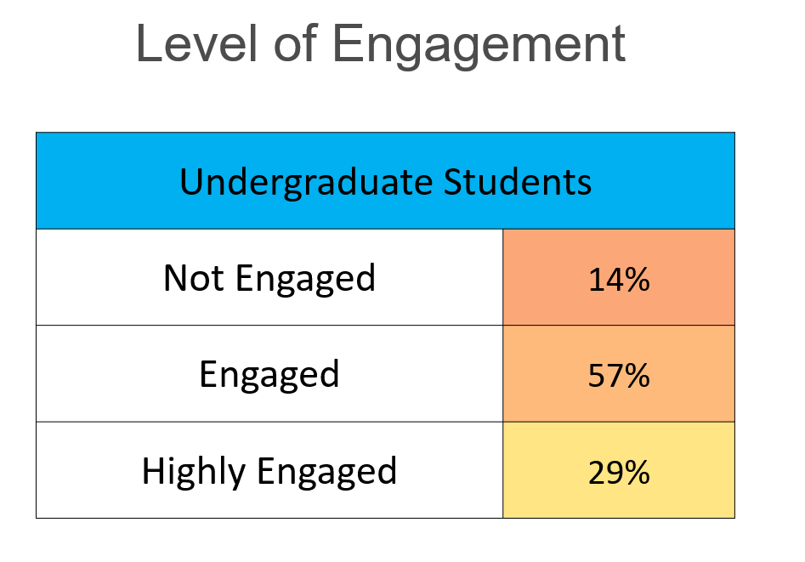
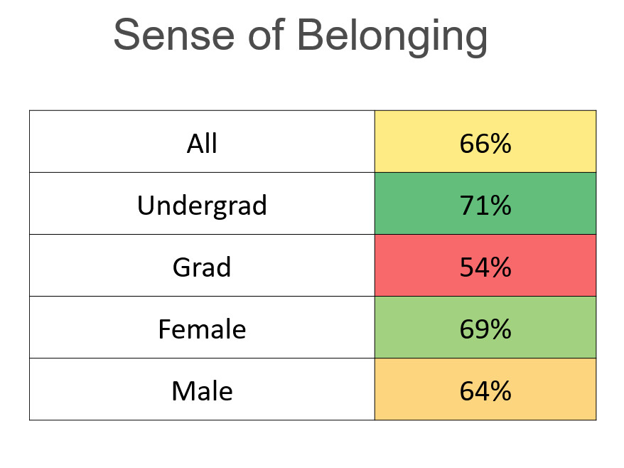
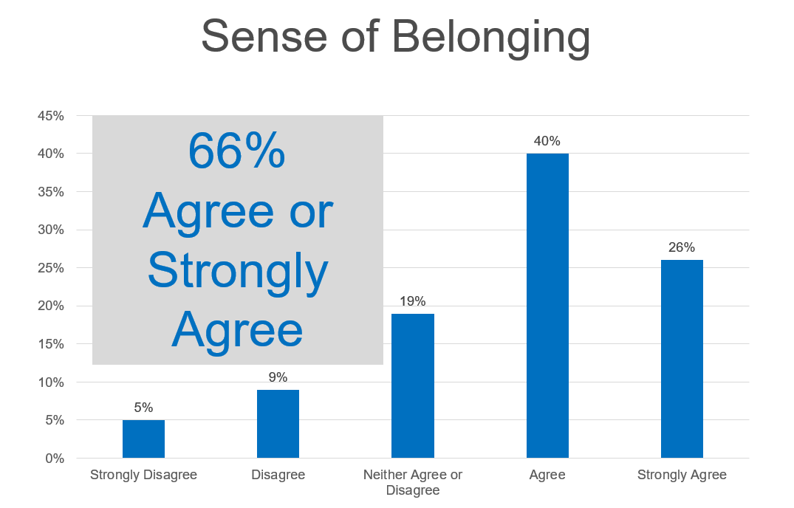

Slide 10
Engagement and Outcomes
 | Not Engaged | Engaged | High Engaged
Thought of Transferring | 33% | 30% | 22%
Thought of Discontinuing College | 22% | 14% | 10%
Satisfaction with Education | 0.9 | 1.1 | 1.2
Satisfaction with out of classroom experience | 0.6 | 1.0 | 1.4
Sense of Belonging - Member of community | 0.1 | 1.0 | 1.4
Sense of Belonging - Sense of belonging | 0.1 | 0.8 | 1.2
Resiliency - Able to adapt to change | 3.0 | 3.2 | 3.3
Resiliency - Tend to bounce back after hardship | 3.0 | 3.2 | 3.4
Learning outcomes - Make difference on campus | -0.6 | 0.3 | 1.0
Learning outcomes - Met individuals with different interests | 1.1 | 1.4 | 1.7
Learning outcomes - Met individuals with similar interests | 1.0 | 1.4 | 1.7
Drinking - Number of drinks when typically drink | 3.0 | 3.5 | 3.4
Stress - Level of stress in past two weeks | 3.0 | 3.0 | 3.0
GPA (SIS data) | 3.09 | 3.21 | 3.33

Slide 11
Satisfaction

Slide 12
Parent: How is School son?
Student: It is great, there is so much to do, I love it!
Parent: How are your classes?
Student: Not sure, there has been so much
other stuff to do…..

Slide 13
Data Science Process
Extensive data process of obtaining, cleaning, merging & carpentry
Exploratory Analysis and Visualization (Revision Request addition)
Initial analysis – machine learning - Python
Load and review, imputation of missing values, balance data, split data
Review regression and correlation
Run Machine Learn Algorithms
Follow-up Analysis based on machine learning finding (or lack of) – StatMath – R
Does the survey data provide the information needed to provide inferences to the client?

Slide 14
Exploration and visualizing of Measures

Slide 15
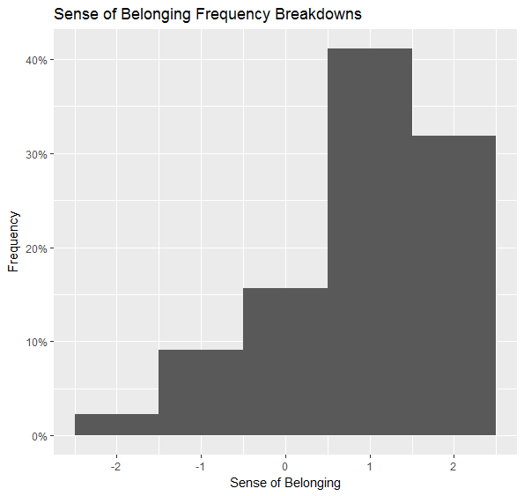
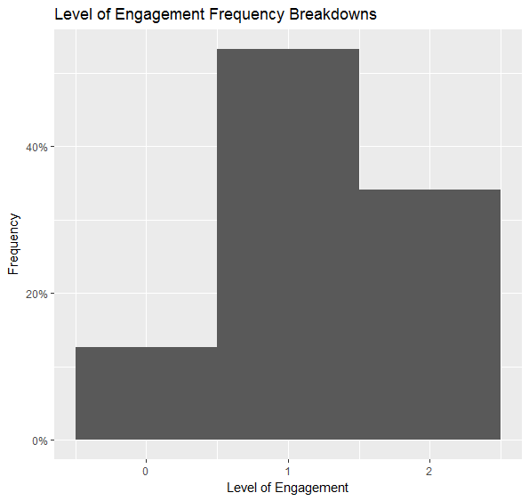
Key Measure Frequencies

Slide 16
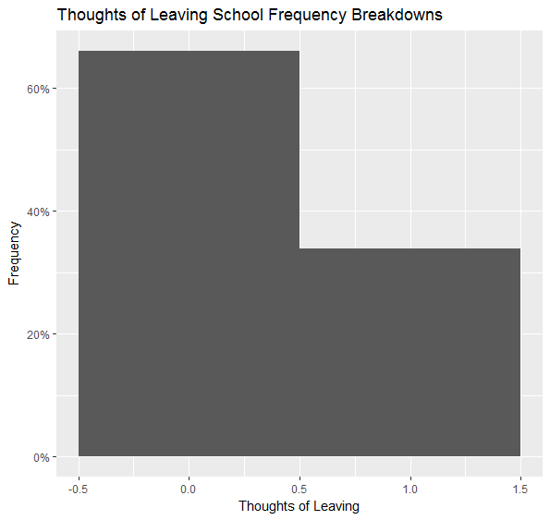
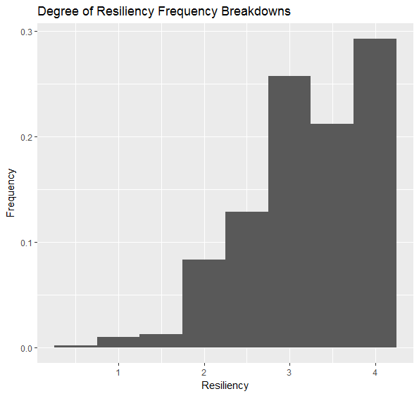
Key Measure Frequencies

Slide 17
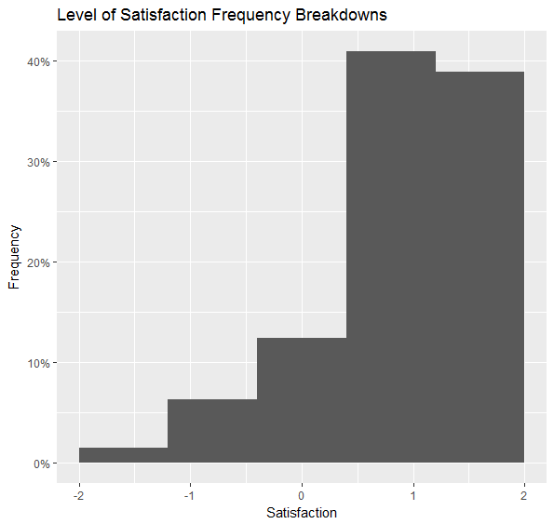
Key Measure Frequencies

Slide 18
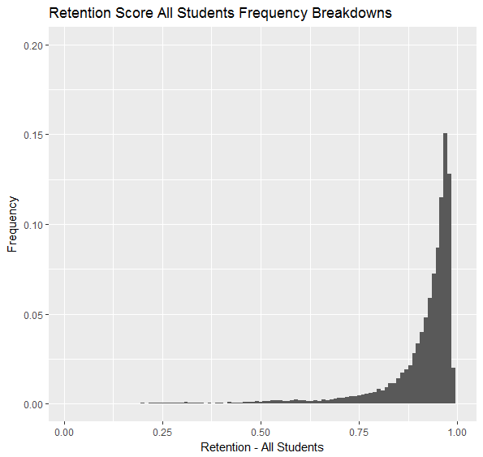
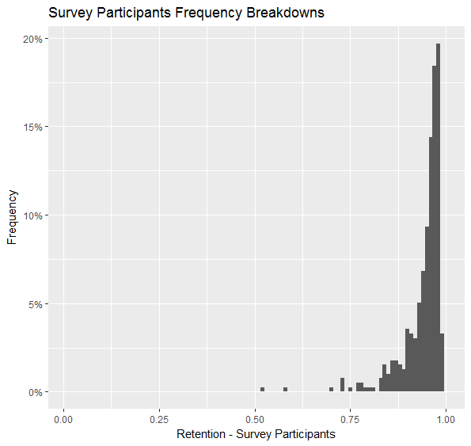
Retention Score Percentages by Survey Participation

Slide 19
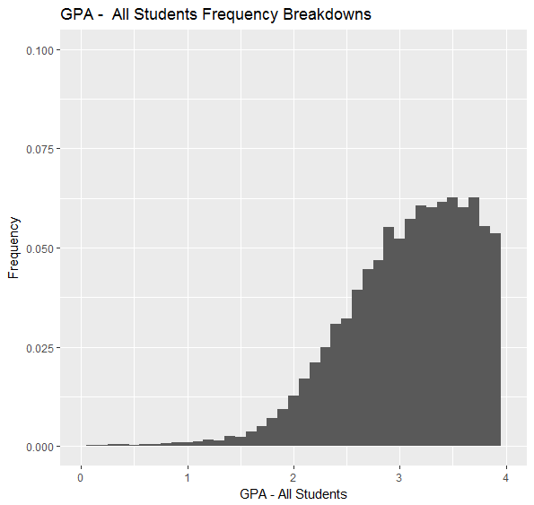
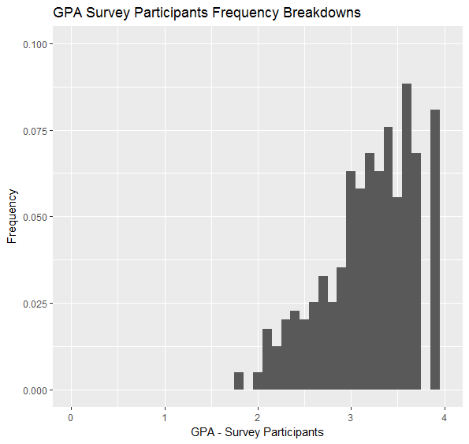
GPA Percentages by Survey Participation

Slide 20
Initial Analysis

Slide 21
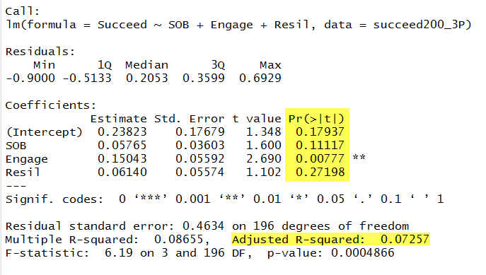
REVIEW REGRESSION

Slide 22
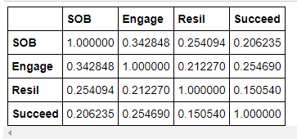
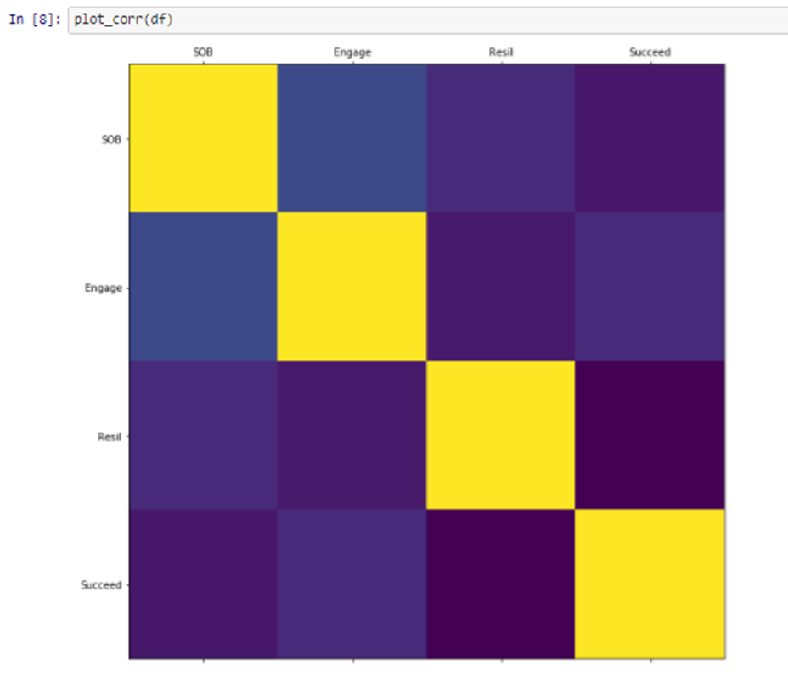
REVIEW CORRELATION
Predictors which did not seem to contribute (Thoughts of Leaving & Resiliency)
removed from analysis

Slide 23
Machine Learning Results
LogisticRegression train = .69 test = .60
LogisticRegression(C=110) train = .70 test = .62
LogisticRegression(C=001) train = .67 test = .57
DescisionTree train = .81 test = .53
DescisionTree (Depth = 4) train = .74 test = .58
Random Forest train = .81 test = .53
Gradient Boost train = .79 test = .58
Gradient Boost (Depth =1 train = .72 test = .60
Gradient Boost (Learn rate =1) train = .72 test = .60
SVC train = .69 test = .62
SVC (C=1000) train = .80 test = .55
MLPClassifier train = .80 test = .55
MLPClassifier (max_iter = 1000) train = .80 test = .55
MLPClassifier (alpha = 1) train = .80 test = .55

Slide 24
Results
within the Survey,
Independent of
Intended Outcomes
from SIS
Yet
Yet

Slide 25
Yet
Yet

Slide 26
What seems to be going on?

Slide 27
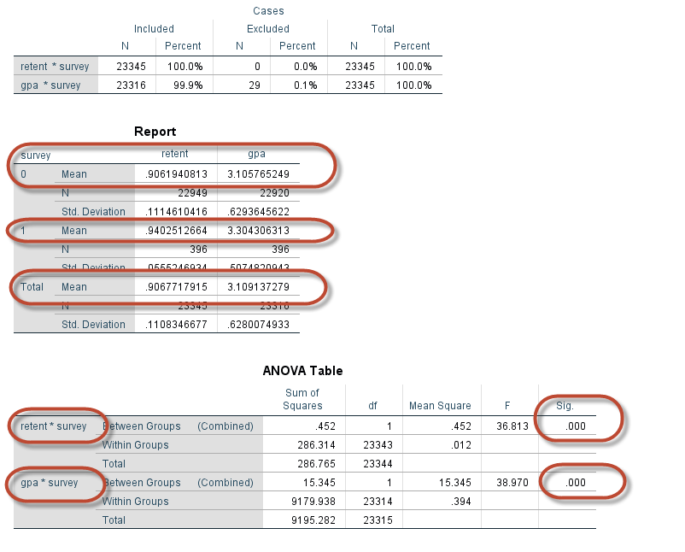
Evidence supporting the Survey Participants are statistically different from the general population.
Retention Score Average
.90 General Population
.94 Survey Sample
Average GPA
3.1 General Population
3.3 Survey Sample

Slide 28
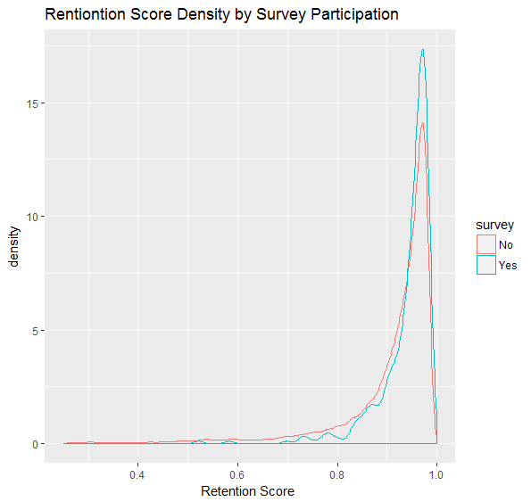
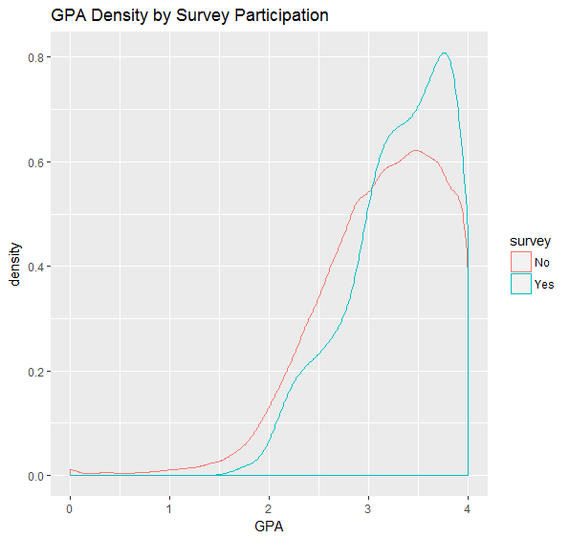
Density Comparisons

Slide 29
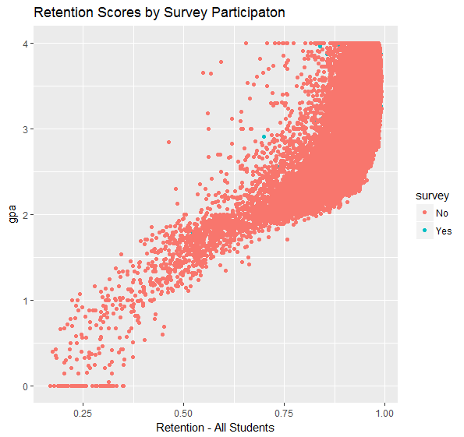
Survey participants (blue dots) washed out due to being only 2% compared to all students

Slide 30
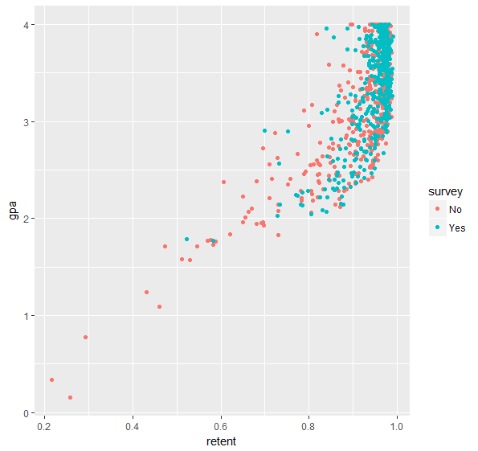
Number of Non-Survey Participants downsampled to equal Survey Participants.
View provides better representation.

Slide 31
Area we wish to make predictions from include only a very small percentage of participation in Survey.

Slide 32
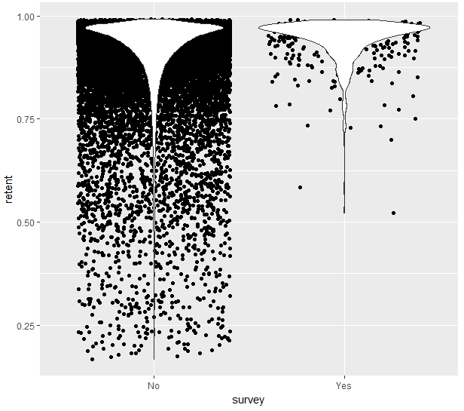
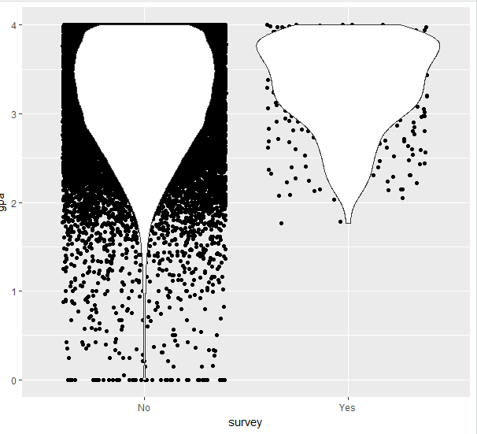
Area we want to predict - No data
Area we want to predict - No data

Slide 33
Results
Student Affairs Key Performance Measures relate to each other, but not to intended outcomes
SOB – Engagement - Satisfaction
Resiliency and Thoughts of Leaving do not predict much
When comparing intend self report outcomes within the survey, model is supported, but…..
When compared to System Level Data, Student Affairs Key Performance Measures do not predict SIS/MU Connect measures of Intended Outcomes
Academic Success
Retention
Graduation

Slide 34
Limitations
Student perceptions and intentions are gathered in Spring, rather than Fall Semester
A strong Selection Bias among survey respondents compared to non respondents
Respondents do not match type of students we want to know more about
Access to data is only recently becoming available.

Slide 35
Recommendations
Fall collection of Key Performance Measures
Summer collection of Intended Outcomes
Devise means of accessing data from type of students we want to know more about – those at risk of leaving
Continue improvement in data access and sharing
Allocation of resources to Student Affairs Assessment Team of Data Scientist
Creation of Avatar or Persona databases for strategic planning?

